Slide 1
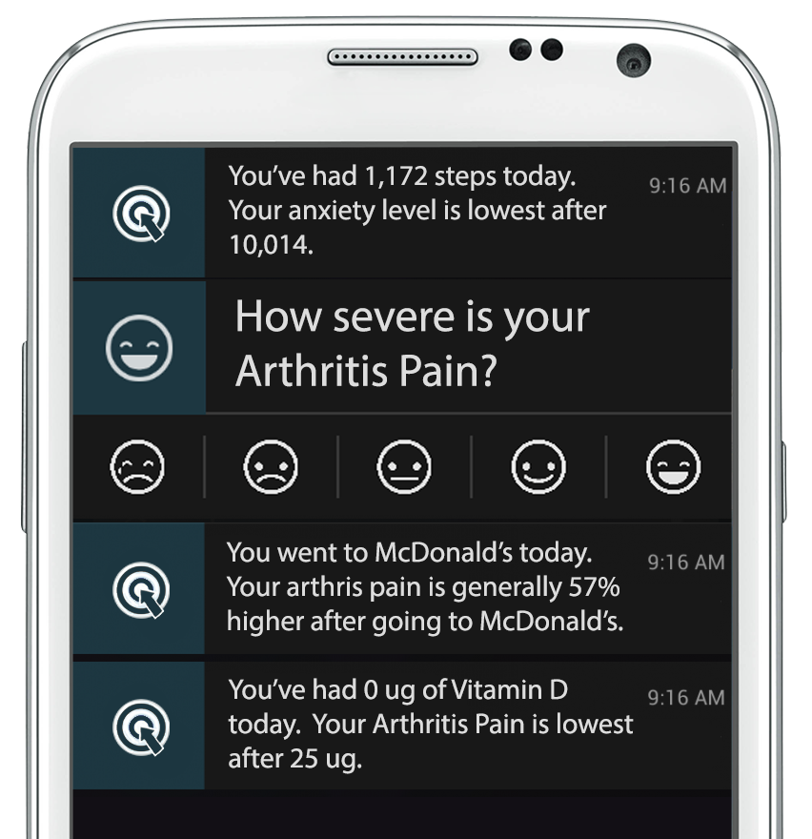


Optomitron
Using machine learning to identify the most effective ways to treat and prevent inflammation-mediated disease.

Slide 2
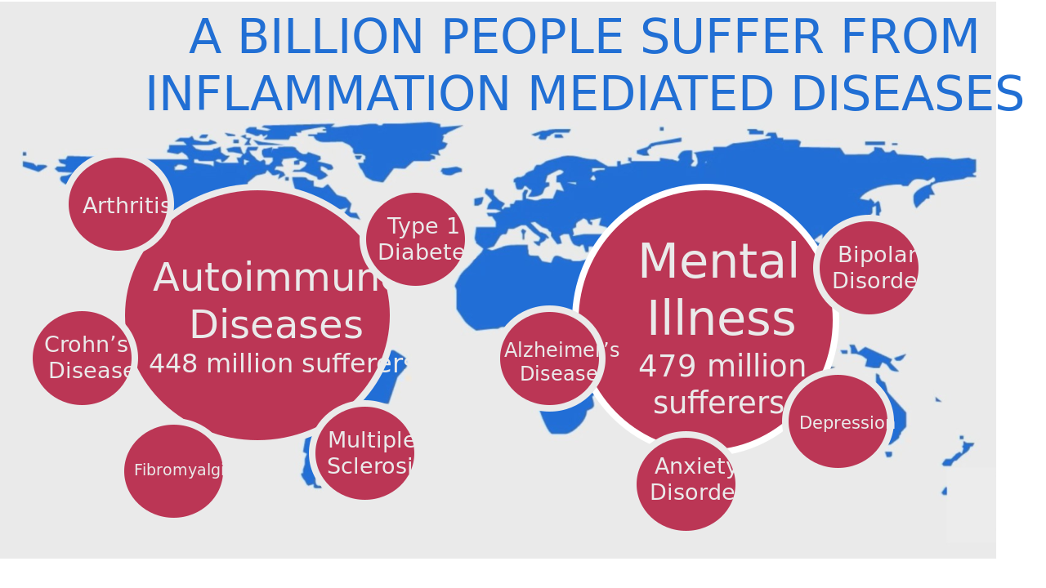

Slide 3
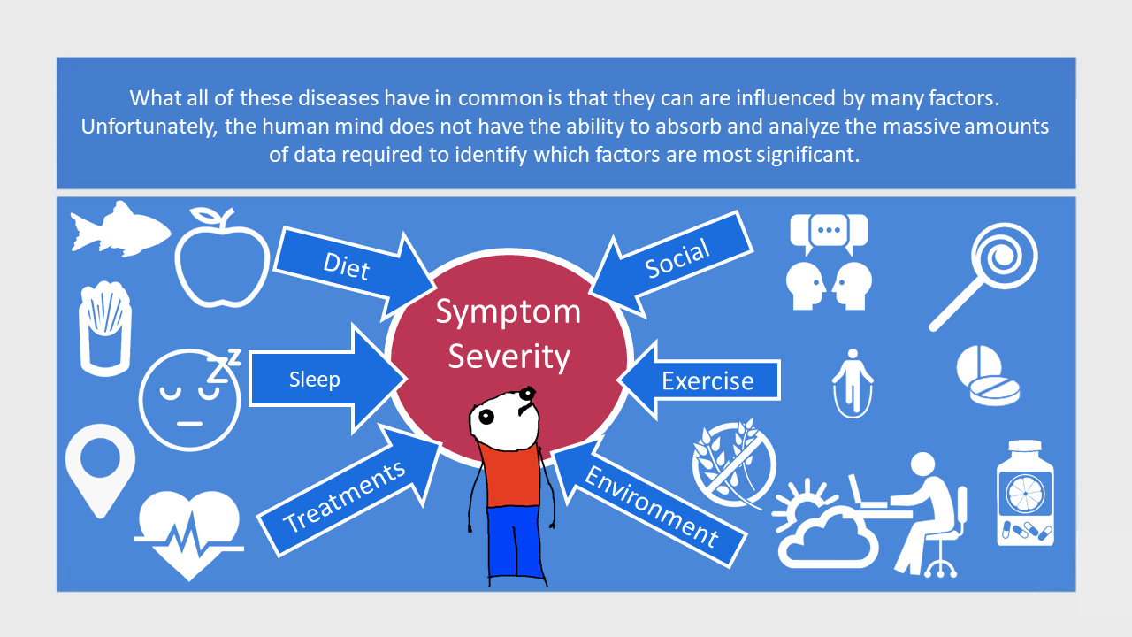

Slide 4
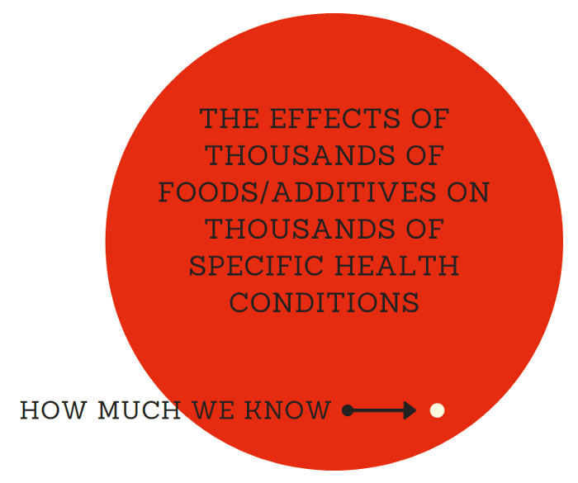

Slide 5
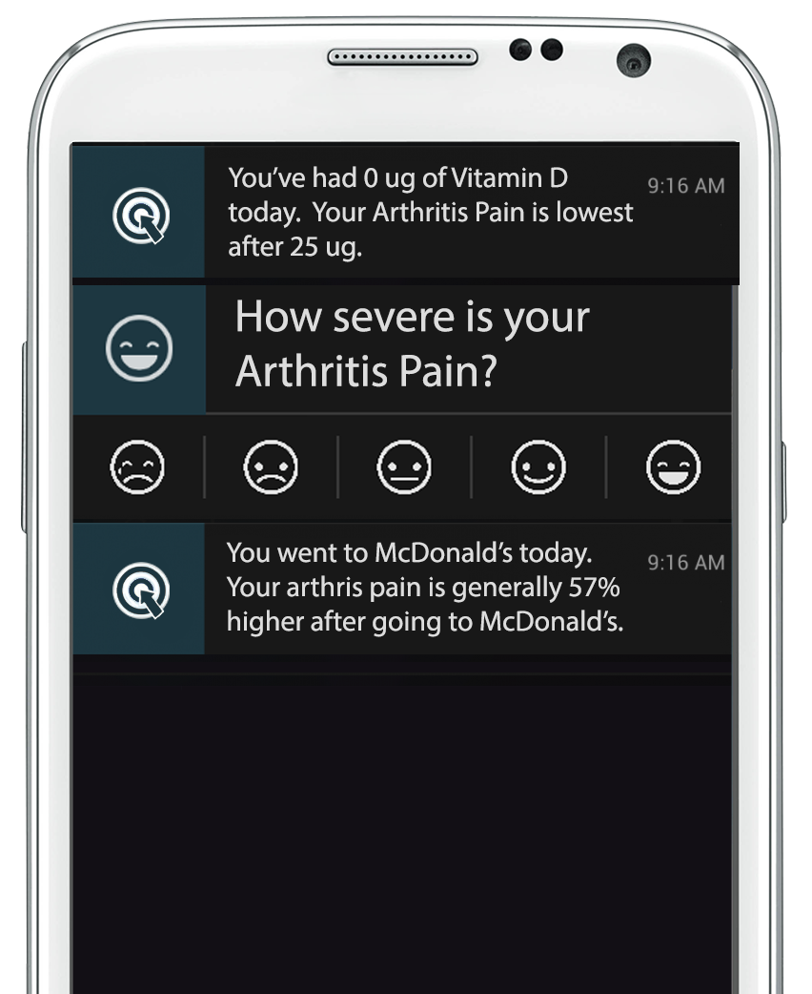
Solution
Real-Time Personalized Recommendations
to Minimize Arthritis Pain

Slide 6
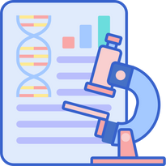



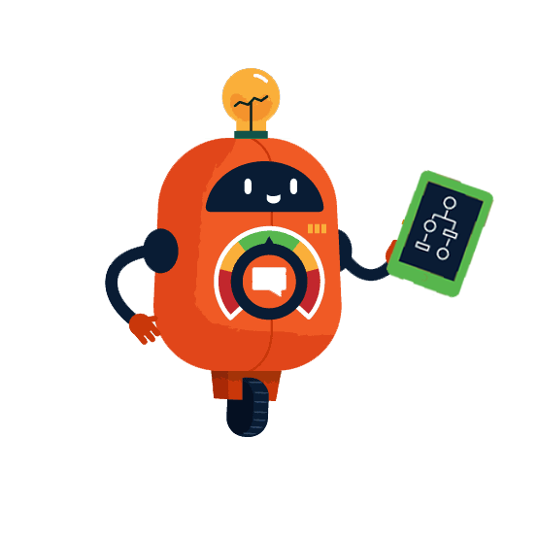

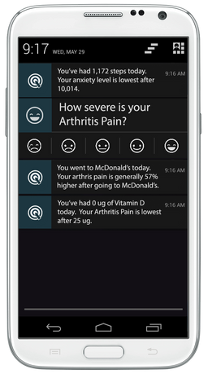



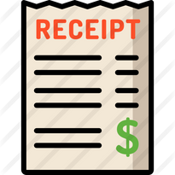
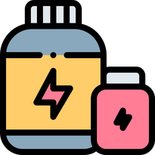
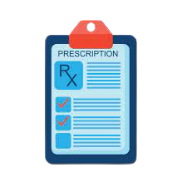
USER RECEIVES OPTIMIZATION RECOMMENDATION PROTOCOL
ALL AVAILABLE FORMAL RESEARCH
MEDICAL AND INSURANCE RECORDS
DIET DATA FROM APPS & FOOD DELIVERY RECEIPTS
ELECTRONIC SUPPLEMENT
RECEIPTS
ELECTRONIC PHARMACY
RECEIPTS
NEW OUTCOME DATA USED TO REFINE PREDICTIVE MODEL

Slide 7
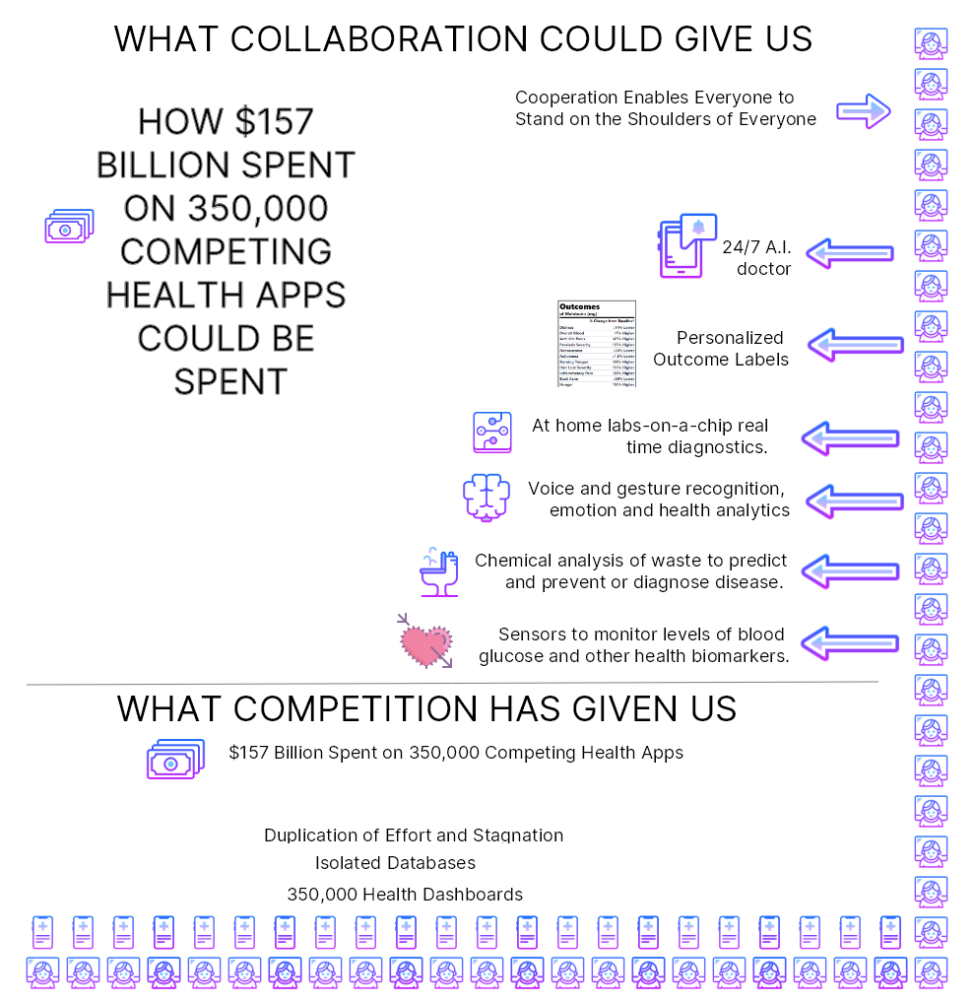
Target Customers
350,000 Digital Health Apps

Slide 8
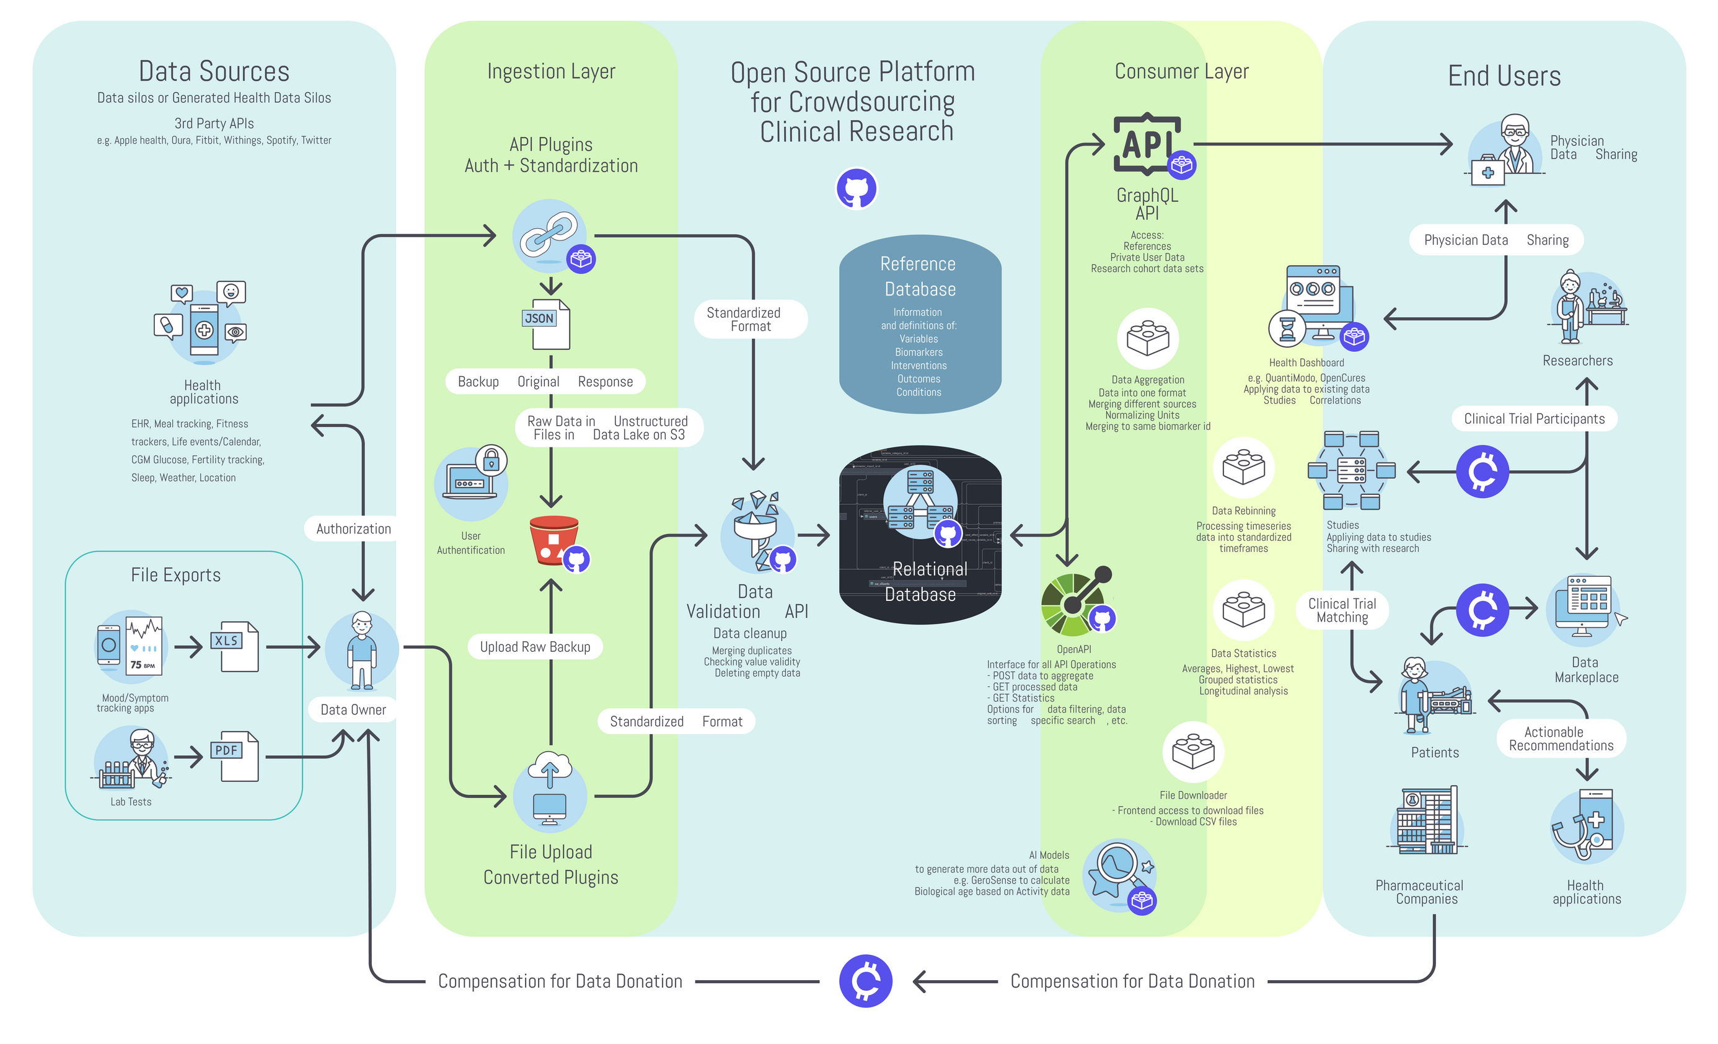

Slide 9
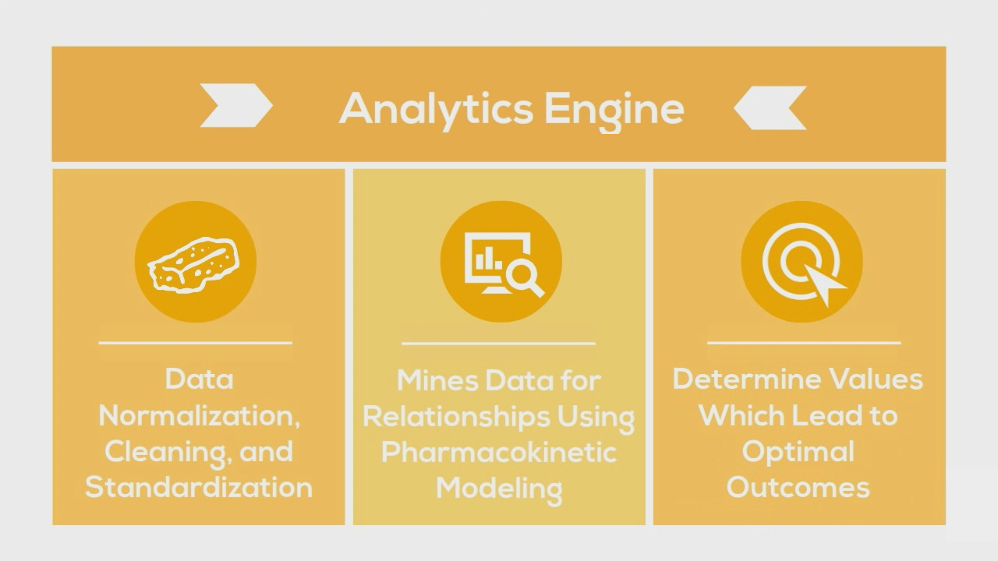
Underlying Technology

Slide 10
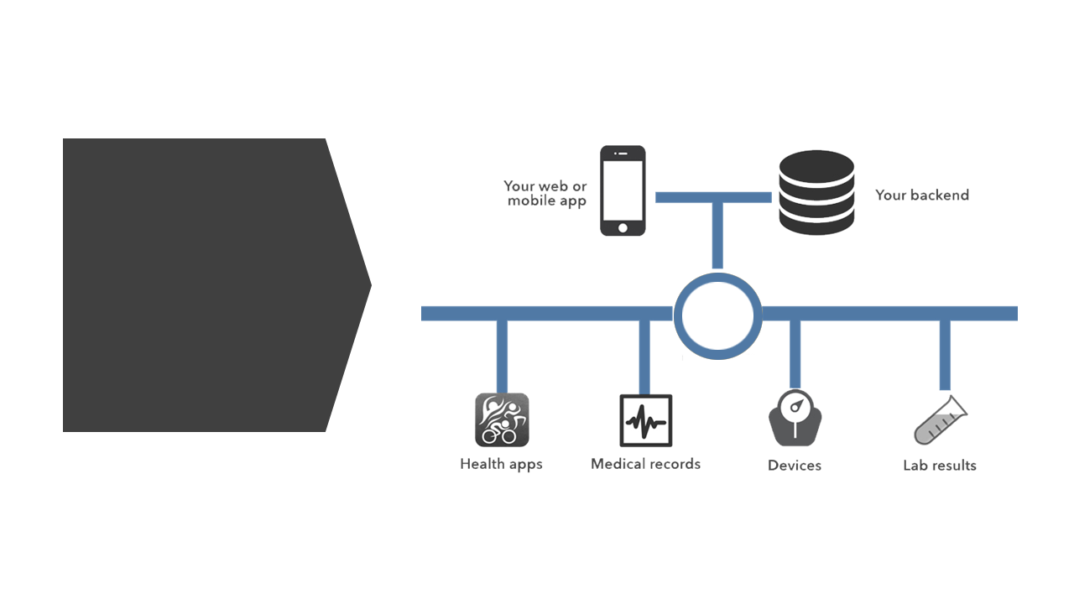
Software-as-a-Service Business Model
Exising Apps
Incorporate
Our Analytics

Slide 11
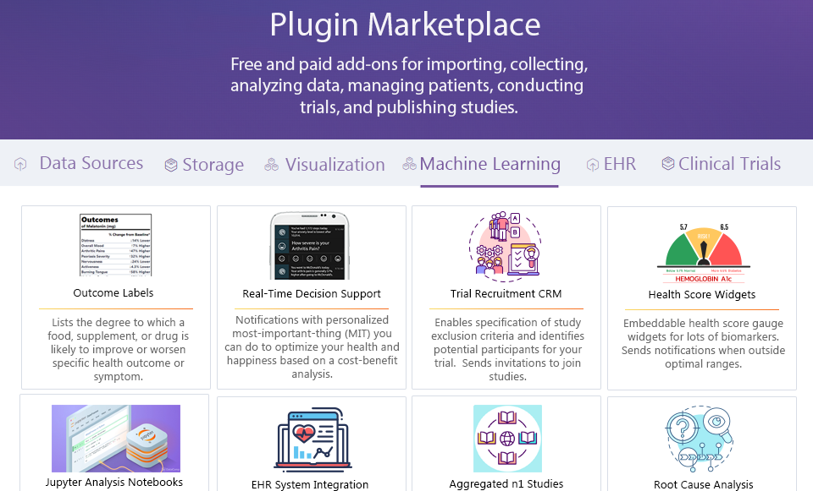

Slide 12
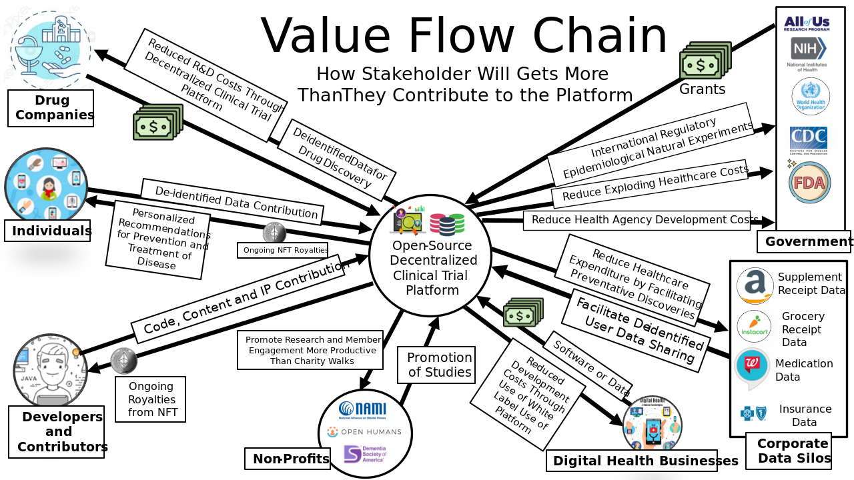

Slide 13
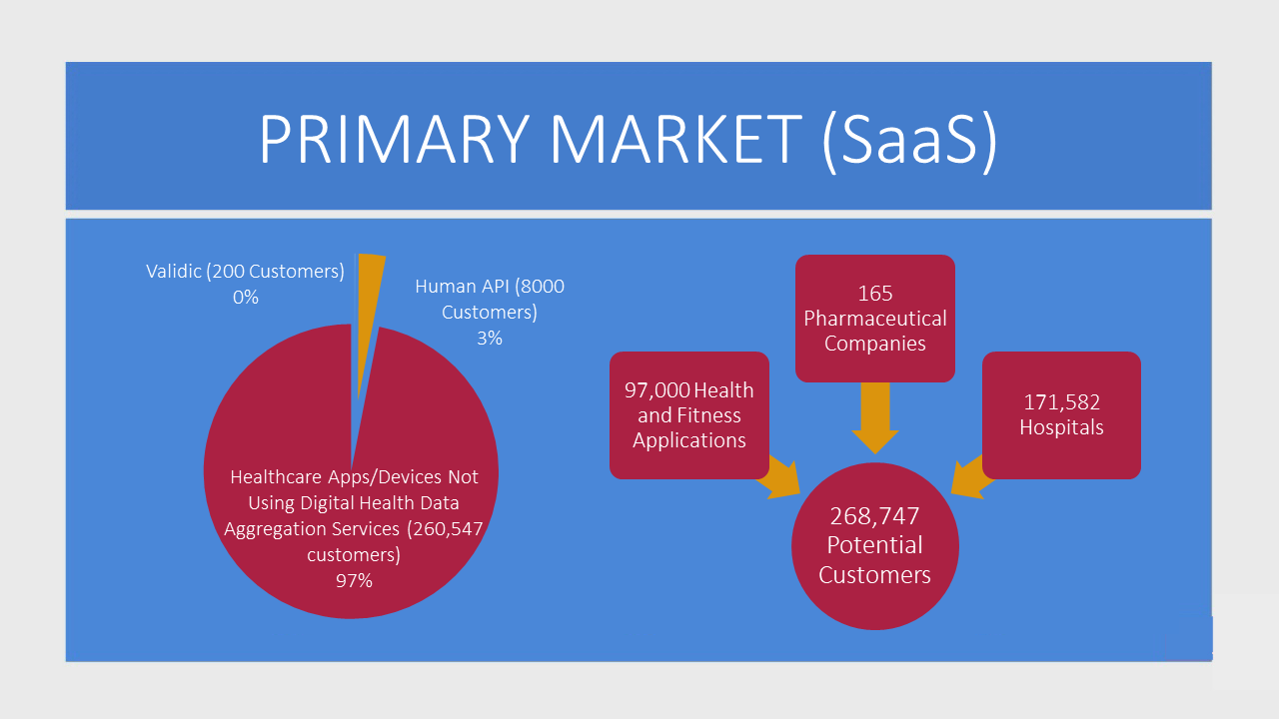

Slide 14
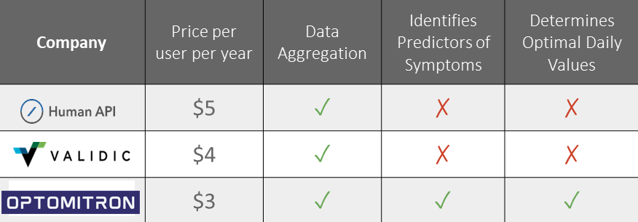
Competitive Landscape
Optomitron

Slide 15
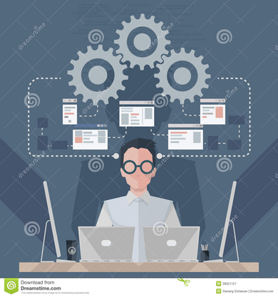







MEET
The
TEAM
Ishan Dutta
Mike P. Sinn
Undergrad Biotechnology student
Software engineer
Nayana Varghese
Chaitrali Yeole
Undergrad Bioengineering student
Undergrad Bioengineering student
Anshumi Patil
Undergrad Bioengineering student

